Slide 1
CHAPTER 2
Atomic Structure
and Bonding

Slide 2
History of Atom
17th century: Robert Boyle asserted that elements are made up of “simple bodies” which themselves are not made up of any other bodies.
19th century: John Dalton stated that matter is made up of small particles called atoms.
19th century: Henri Becquerel and Marie and Pierre Curie in France, introduced the concept of radioactivity.
Joseph J. Thompson found electrons.
In 1910, Ernest Rutherford found protons.
In 1932, James Chadwick found neutrons.

Slide 3
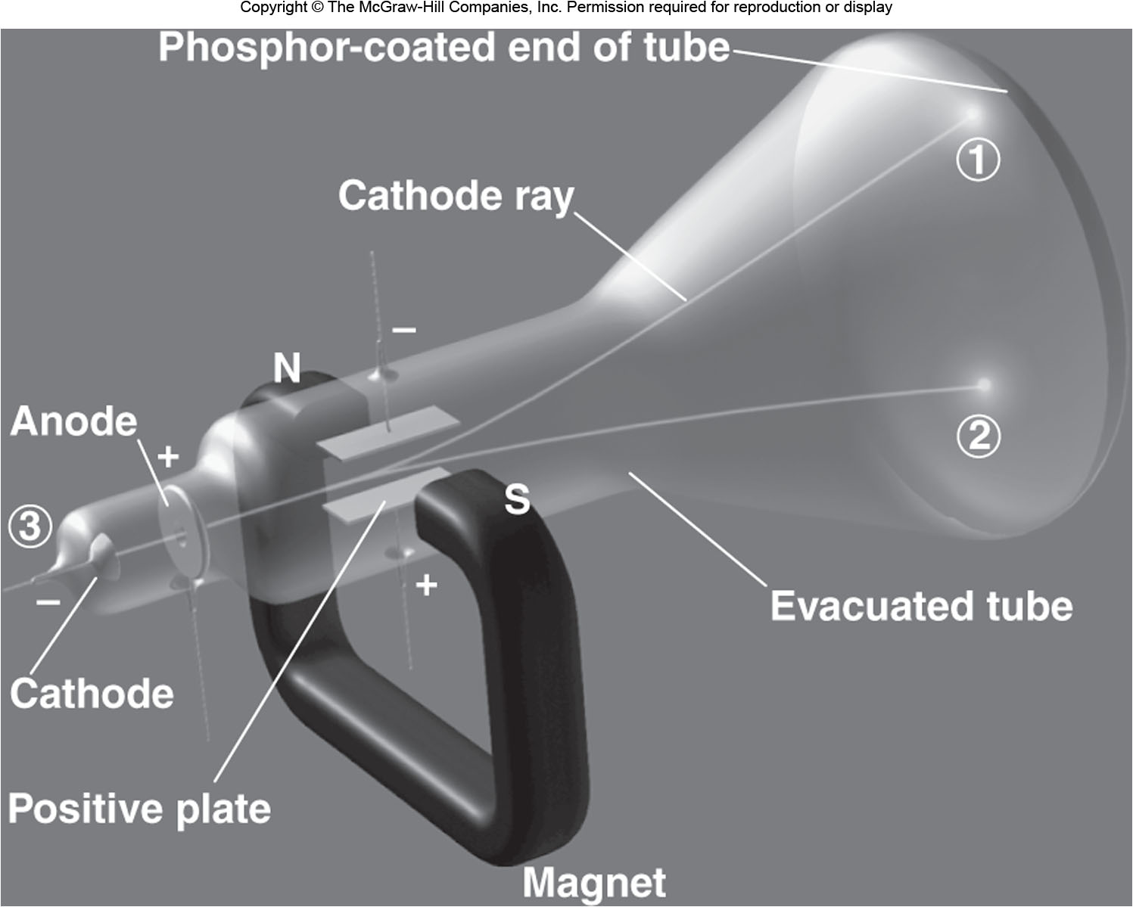
A Cathode Ray Tube
Joseph J. Thompson found electrons and calculated the ratio of mass/ electron charge = 5.60 × 10⁻⁹ g/C. Robert Millikan found the charge of electron to be −1.60 × 10⁻¹⁹ C . ∴ Mass of e⁻ = 8.96 × 10⁻²⁸ g.

Slide 4
History of Atom
Rutherford experiment: Bombarded a very thin foil of gold with positively charged α particles. (Animation)
Most of atom must be made up of empty space.
A small neighborhood at center of the atom, the nucleus, houses positively charged particles of its own.
Protons: +1.60 × 10⁻¹⁹ C, 1.672 × 10⁻²⁴ g.
Atoms are electrically neutral, they must be have an equal number of electrons and protons. Atom mass is larger the mass of protons alone.
Chadwick provided the first evidence of neutron.
Neutrons: No electrical charge, 1.674 × 10⁻²⁴ g.

Slide 5

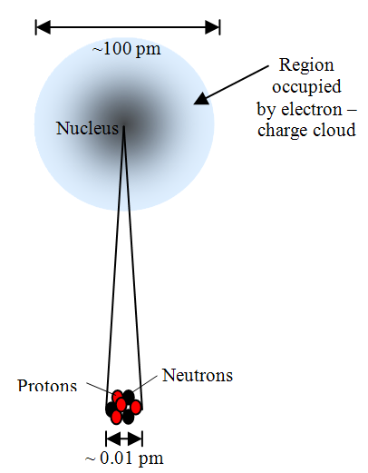
Structure of Atoms
ATOM
Basic Unit of an Element
Diameter : 10 ^{–10} m
Neutrally Charged
Nucleus
Diameter: 10 ^{–14} m
Accounts for almost all mass
Positive Charge
Electron Cloud
Mass: 9.109 × 10 ^{–28} g
Charge: −1.602 × 10 ^{–19} C
Accounts for all volume
Proton
Mass: 1.673 × 10 ^{–24} g
Charge: 1.602 × 10 ^{–19} C
Neutron
Mass: 1.675 × 10 ^{–24} g
Neutral Charge

Slide 6
Atomic Number and Atomic Mass
Atomic Number (Z) 原子序= Number of Protons in the nucleus
Unique to an element
Example: Hydrogen = 1, Uranium = 92
Relative atomic mass = Mass in grams of 6.203 × 10²³
(Avagadro Number) Atoms.
The mass number 質量數 (A) is the sum of protons and neutrons in a nucleus of an atom.
Example: Carbon has 6 Protons and 6 Neutrons. A = 12.
One Atomic Mass unit (amu) is 1/12th of mass of ¹²C atom.
One gram mole (mol) = Gram atomic mass of an element.
Isotope: Variations of element with same atomic number but different mass number. ¹H₂O、 ²H₂O(重水)
One gram
Mole of
Carbon
12 Grams
of Carbon
6.023 × 10²³
Carbon
Atoms

Slide 7
Example Problem
A 100 gram alloy of nickel and copper consists of 75 wt% Cu and 25 wt% Ni. What are percentage of Cu and Ni atoms in this alloy?
Given: 75 g Cu Atomic Weight: 63.542
25 g Ni Atomic Weight: 58.69
Number of gram moles of Cu =
Number of gram moles of Ni =
Atomic Percentage of Cu =
Atomic Percentage of Ni =

Slide 8
Example Problem
An intermetallic compound has the chemical formula Ni_{x}Al_{y}, where x and y are simple integers, and consists of 42.04 wt% nickel and 57.96 wt% aluminum. What is the simplest formula of this nickel aluminide?
No. of moles of Ni = 42.04 g Ni / 1 mol Ni /58.71 g Ni = 0.7160 mol
No. of moles of Al = 57.96 g Al / 1 mol Al /26.98 g Al = 2.148 mol
Total = 2.864 mol
Mole fraction of Ni = 0.7160 / 2.864 = 0.25
Mole fraction of Al = 2.148 / 2.864 = 0.75
The simplest formula is Ni_{0.25}Al_{0.75}. or NiAl₃.

Slide 9
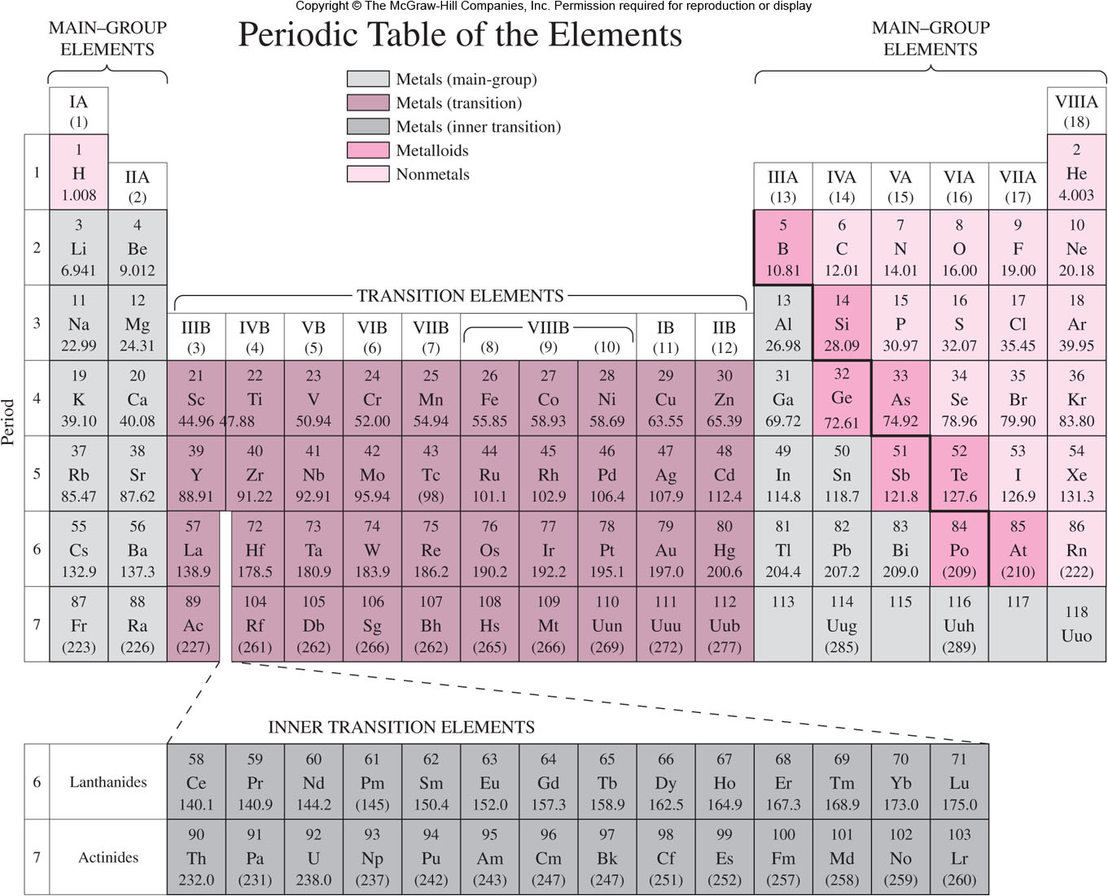
Periodic Table (Mendeleev)

Slide 10
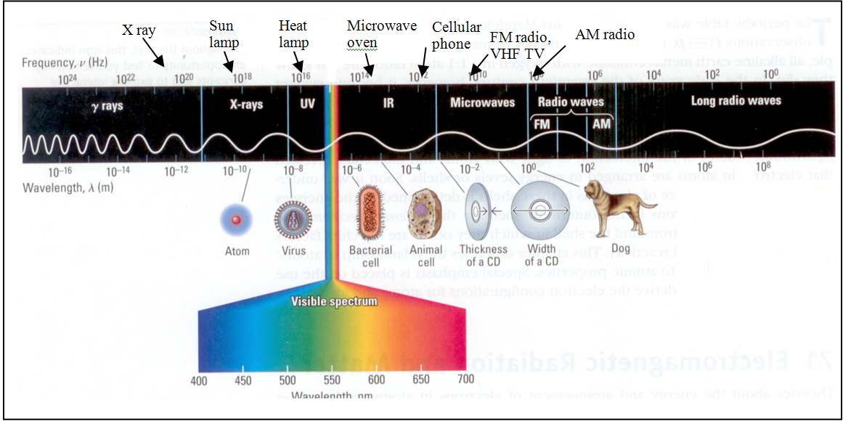
Planck’s Quantum Theory
Max Planck, discovered that atoms and molecules emit energy only in certain discrete quantities, called quanta.
James Clerk Maxwell proposed that the nature of visible light is in the form of electromagnetic radiation.
υ = c/λ; E = hυ = hc/λ
Energy is always released in integer multiples of hυ.

Slide 11
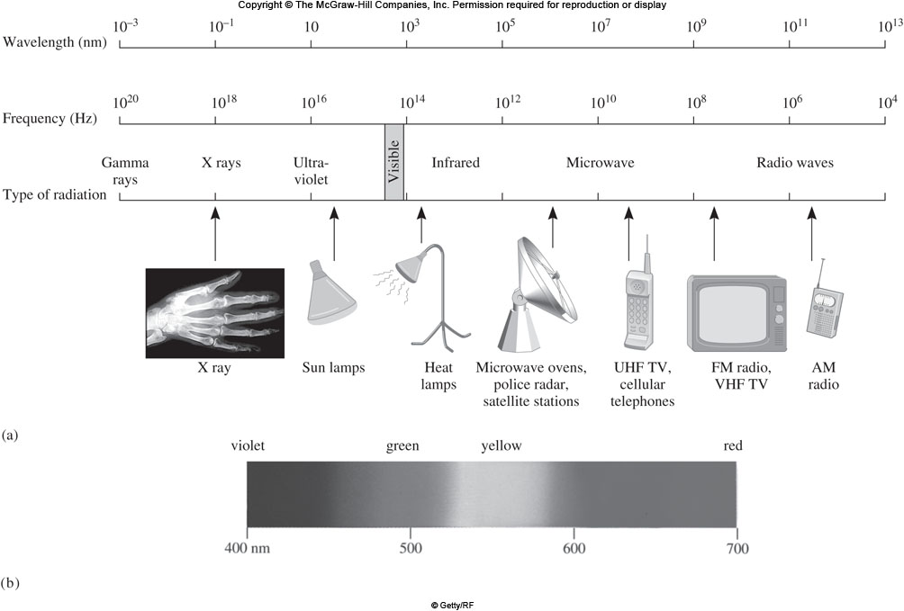
Electromagnetic Spectrum

Slide 12
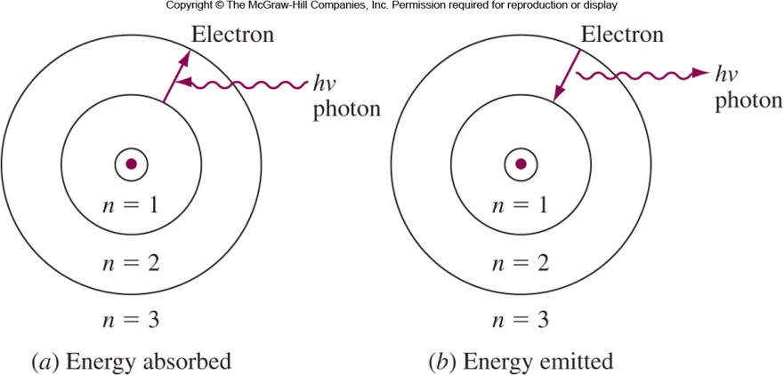
Electron Structure of Atoms: Bohr’s Theory
Electron rotates at definite energy levels.
Energy is absorbed to move to higher energy level.
Energy is emitted during transition to lower level.
Energy change due to transition = ΔE = hc/λ h = Planks constant = 6.63 × 10⁻³⁴ J⋅s c = Speed of light, λ = Wavelength of light

Slide 13
Energy in Hydrogen Atom
Hydrogen atom has one proton and one electron
Energy of hydrogen atoms for different energy levels is given by n = 1, 2….., principal quantum numbers 主量子數
Example: If an electron undergoes transition from n = 3 state to n = 2 state, the energy of photon emitted is
Energy required to completely remove an electron from hydrogen atom is known as ionization energy 電離能.

Slide 14
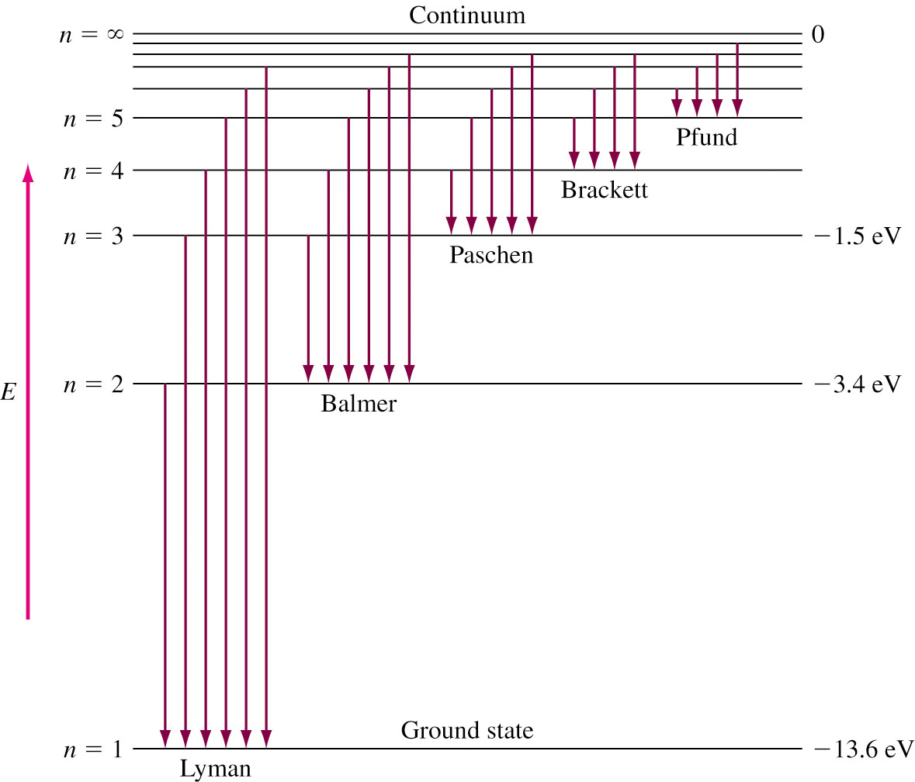
Emission Spectrum of Hydrogen
n: Principle quantum number
Infrared emissions
Visible emissions
Ultraviolet emissions
Emission Spectra Animation

Slide 15
Uncertainty Principle
Bohr’s model fails to explain complex atoms.
Louis de Broglie: Particles of matter such as electrons could be treated in terms of both particle and wave.
λ = h / mv
Werner Heisenberg (uncertainty principle): It is impossible to simultaneously determine the exact position and the exact momentum of a body.
Δx⋅mΔu ≥ h/4π Δx is the uncertainty in the position, and Δu is the uncertainty in speed.
We can only provide the probability of finding an electron with a given energy within a given space (electron density).

Slide 16
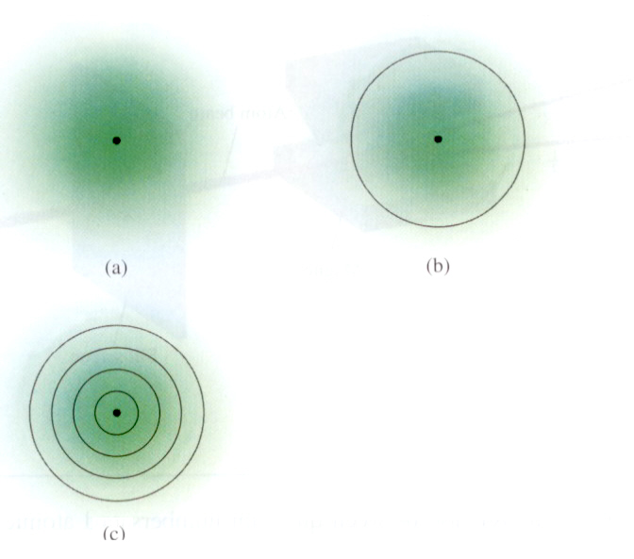
Schrodinger’s Wave Functions
Solution of the wave equation is in terms of a wave function, ψ (orbital). Unlike the “orbit” of Bohr.
The square of the wave function, ψ², represents electron density (probability)..
Boundary surface diagram of H, 90 % ~ 100 pm 100 % ~ ∞
Total probability (Radial probability): Maximum at 50 pm.
0.1 nm
ground state
90% boundary surface diagram state
Radial probability distribution.
0.05 nm
Successive spherical shells.

Slide 17
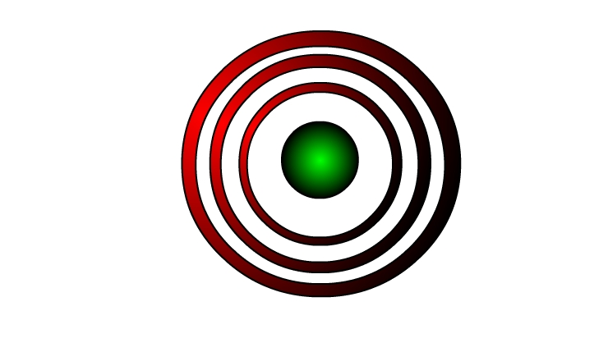

Quantum Numbers of Electrons of Atoms
Principal Quantum Number (n)
Represents main energy levels.
Range 1 to 7.
Larger the ‘n’, higher the energy.
Subsidiary Quantum Number (l)
Represents sub-energy levels (orbital).
Range 0, 1, 2…, n−1.
Represented by letters s, p, d, and f.
n = 1
s orbital (l = 0)
n = 2
n = 2
n = 1
n = 3
p orbital
(l = 1)

Slide 18
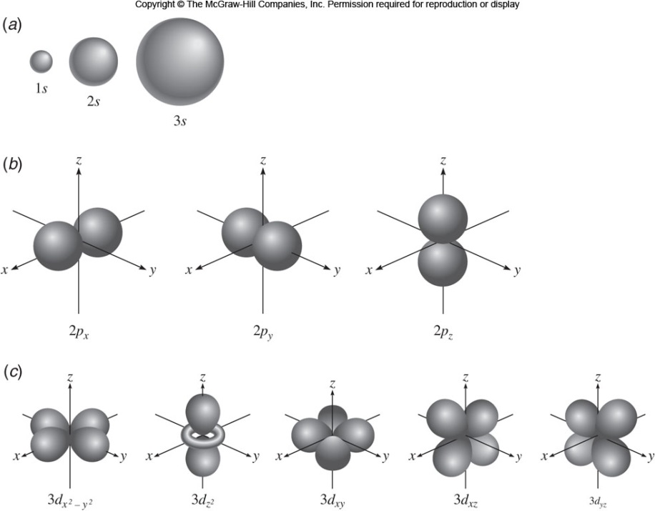
s, p, and d Orbitals
Hybridization: Animation

Slide 19
Quantum Numbers of Electrons of Atoms
Magnetic Quantum Number m_{l}
Represents spatial orientation of single atomic orbital.
Permissible values are –l to +l.
Example: if l = 1 ⇒ m_{l} = −1, 0, +1.
i.e. 2l + 1 allowed values.
No effect on energy.
Electron Spin Quantum Number m_{s}
Specifies two directions of electron spin.
Directions are clockwise or anticlockwise.
Values are +1/2 or –1/2.
Two electrons on same orbital have opposite spins.
No effect on energy.
Pauli’s exclusion principle: No more than two electrons can occupy the same orbital of an atom, and the two electrons must have opposite spins.

Slide 20
Electron Structure of Multielectron Atom
Maximum number of electrons in each atomic shell is given by 2n².
Atomic size (radius) increases with addition of shells.
Electron configuration lists the arrangement of electrons in orbital.
Example (Mg):
1s² 2s² 2p⁶ 3s²
For Iron, (Z = 26), electronic configuration is
1s² 2s² sp⁶ 3s² 3p⁶ 3d⁶ 4s²
Orbital letters
Number of Electrons
Principal Quantum Numbers

Slide 21
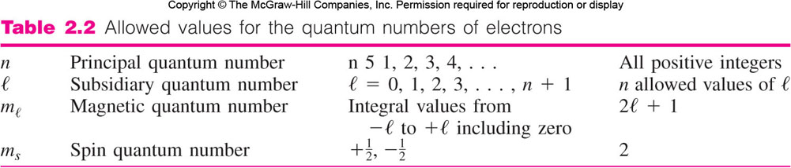
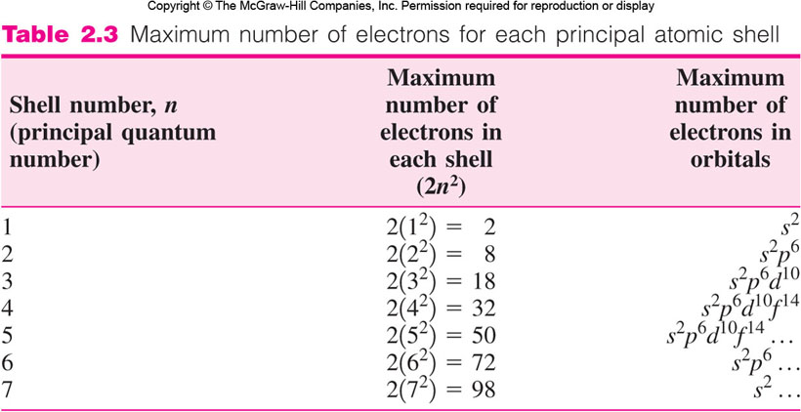
=
n − 1

Slide 22
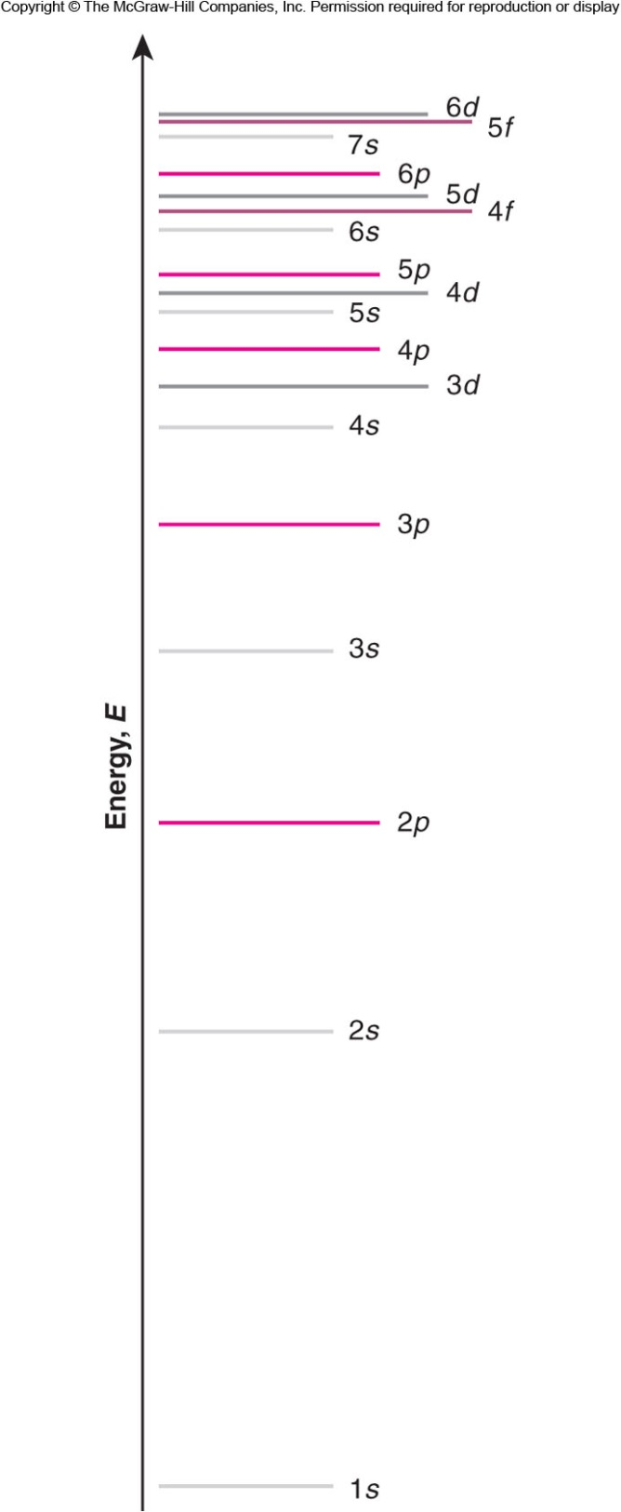
Multielectron Atoms
Nucleus charge effect: The higher the charge of the nucleus, the higher is the attraction force on an electron and the lower the energy of the electron. Ionized energy: H: −1311 kJ/mol vs. He⁺: −5250 kJ/mol
Shielding effect: Electrons shield each other from the full force of the nucleus. He: −2372 kJ/mol vs. He⁺: −5250 kJ/mol
The inner electrons shield the outer electrons and do so more effectively.
In a given principal shell, n, the lower the value of l, the lower will be the energy of the subshell; s < p < d < f.

Slide 23
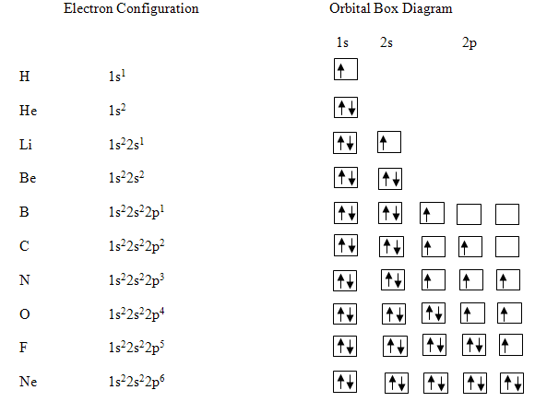
The Quantum-Mechanical Model
Elements are classified according to their ground state electron configuration.

Slide 24
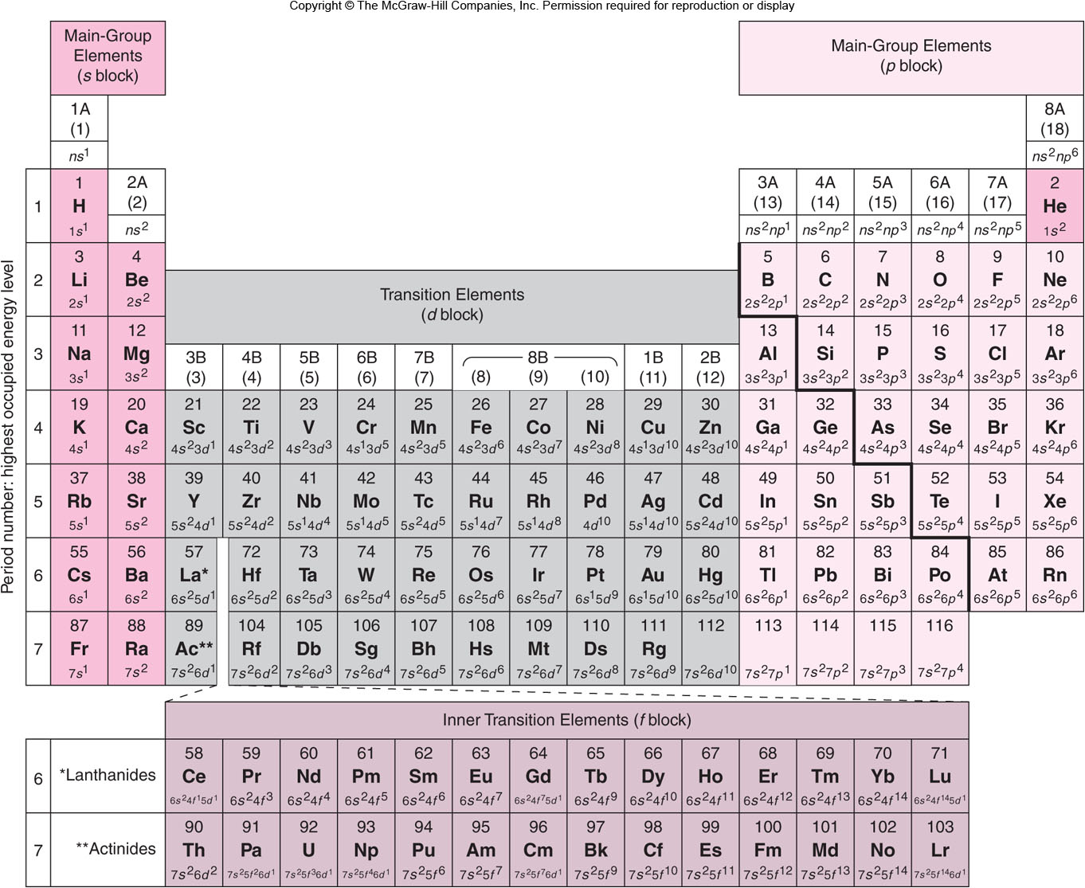
Periodic Table
Source: Davis, M. and Davis, R., Fundamentals of Chemical Reaction Engineering, McGraw-Hill, 2003.

Slide 25
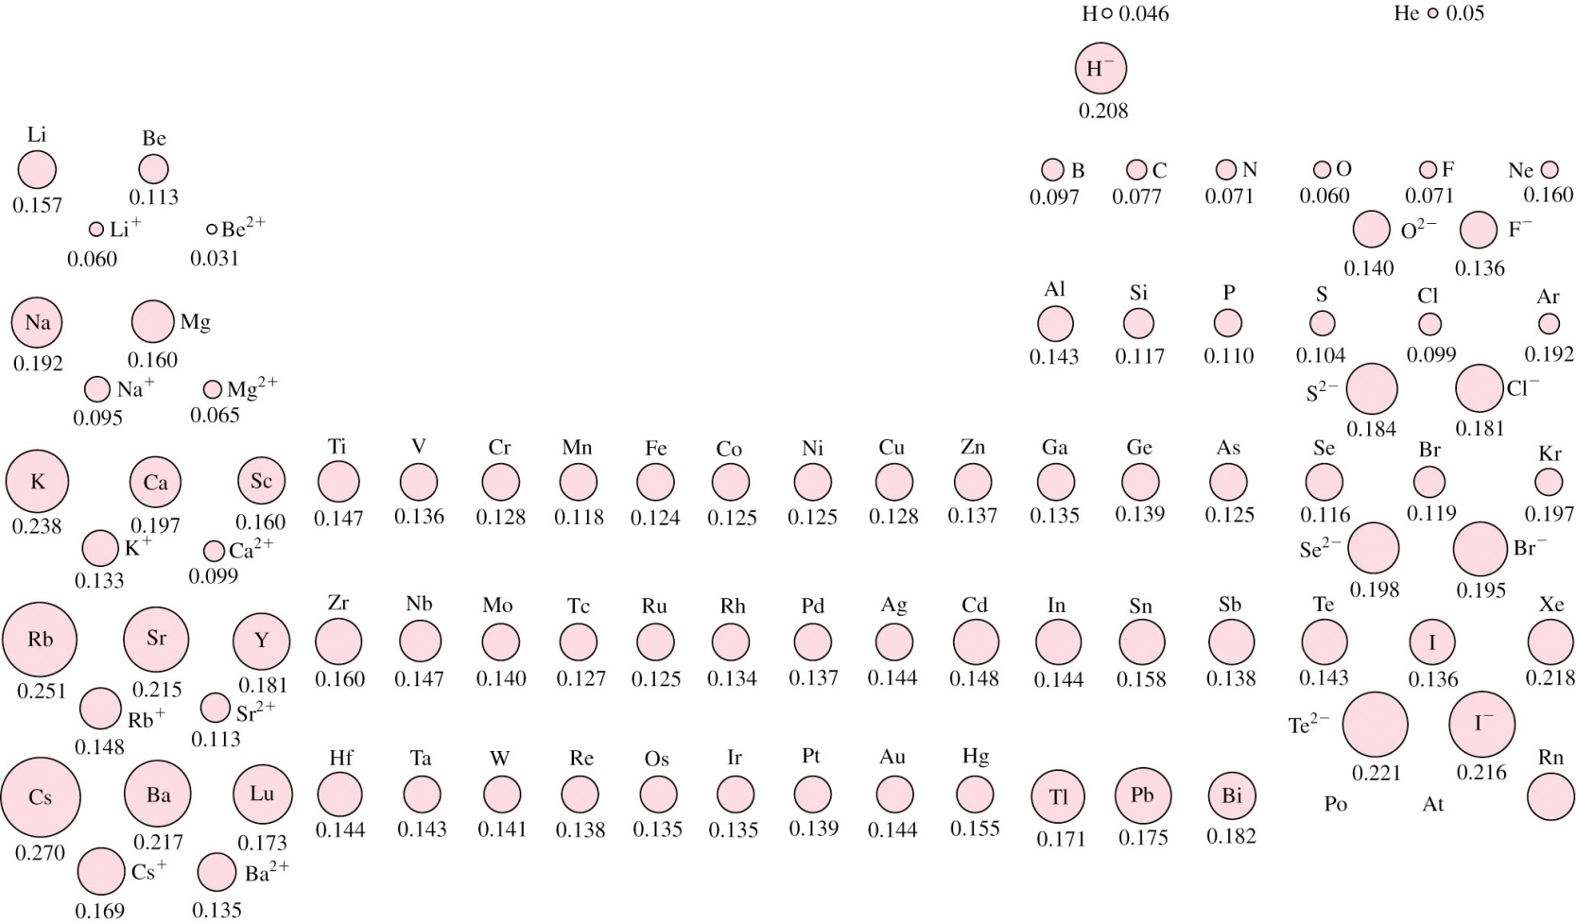
Atomic and Ionic Size
Atomic size: half the distance between the nuclei of two adjacent atoms (metallic radius) or identical (covalent radius).
Affected by principal quantum number and size of the nucleus.

Slide 26
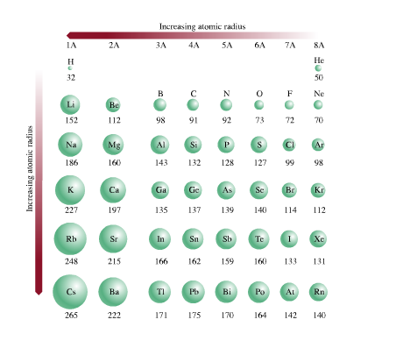
Atomic Radius Trends

Slide 27
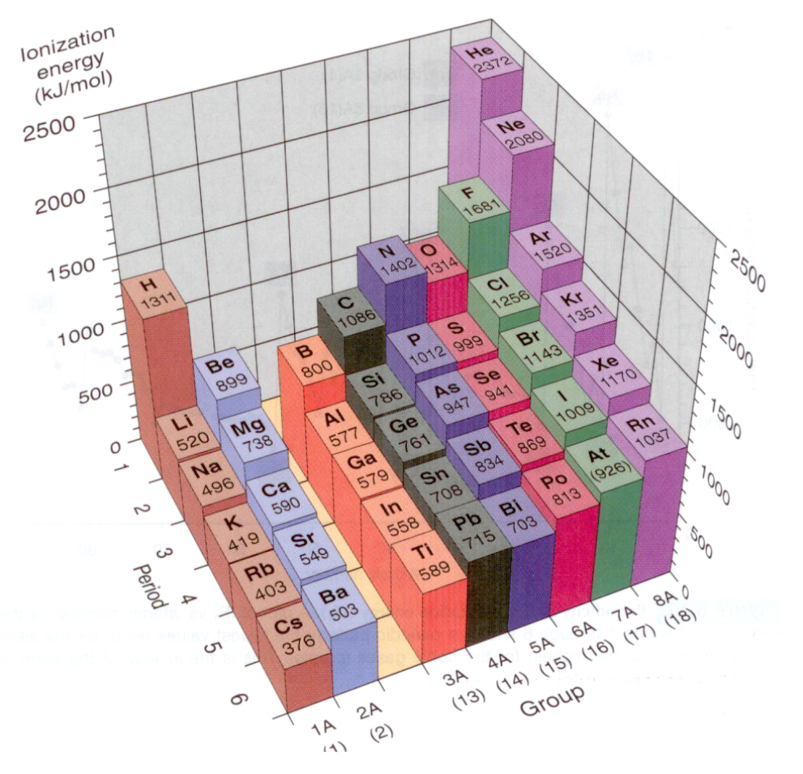
Trends in Ionization Energy
Energy required to remove an electron from its atom.
First ionization energy plays the key role in the chemical reactivity.
As the atomic size
decreases it takes
more energy to
remove an electron.
As the first outer core
electron is removed,
it takes more energy
to remove a second
outer core electron. 0.52、7.3、12 MJ/mol. (Li Li⁺ Li²⁺)

Slide 28
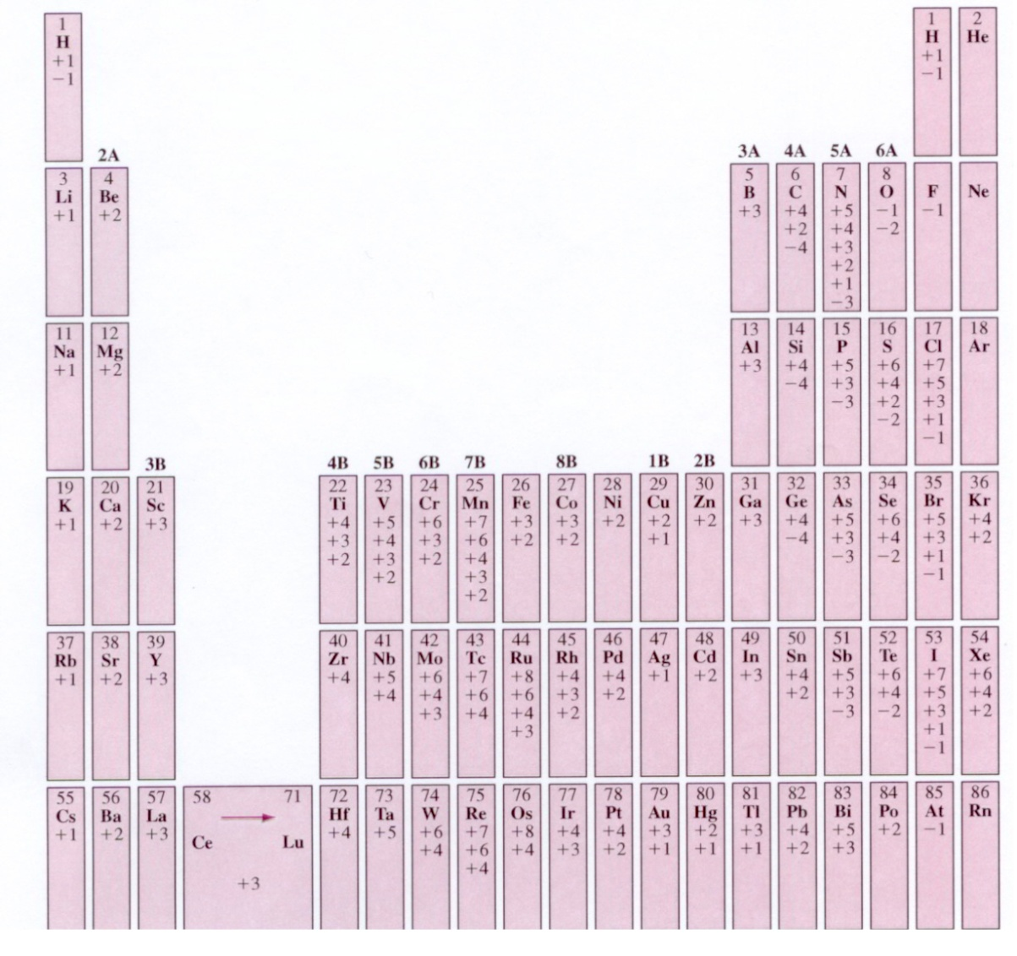
Oxidation Number
Positive oxidation number: The number of outer electrons that an atom can give up through the ionization process.

Slide 29
Electron Structure and Chemical Activity
Except Helium, most noble gasses (Ne, Ar, Kr, Xe, Rn) are chemically very stable
All have s² p⁶ configuration for outermost shell.
Helium has 1s² configuration
Electropositive elements give electrons during chemical reactions to form cations.
Cations are indicated by positive oxidation numbers
Example:
Fe : 1s² 2s² sp⁶ 3s² 3p⁶ 3d⁶ 4s²
Fe²⁺ : 1s² 2s² sp⁶ 3s² 3p⁶ 3d⁶
Fe³⁺ : 1s² 2s² sp⁶ 3s² 3p⁶ 3d⁵

Slide 30
Electron Structure and Chemical Activity
Electronegative elements accept electrons during chemical reaction.
Some elements behave as both electronegative and electropositive.
Electronegativity is the degree to which the atom attracts electrons to itself
Measured on a scale of 0 to 4.1
Example: Electronegativity of Fluorine is 4.1
Electronegativity of Sodium is 1.
Na
Te
N
O
F
Electro-
positive
Electro-
negative
0
K
1
W
2
H
Se
3
4

Slide 31
Trends in Electron Affinity
Electron affinity: Tendency to accept one or more electrons and release energy.
Electron affinity increases (more energy is released after accepting an electron) as we move to the right across a period and decreases as we move down in a group.
Groups 6A and 7A have in general the highest electron affinities.

Slide 32
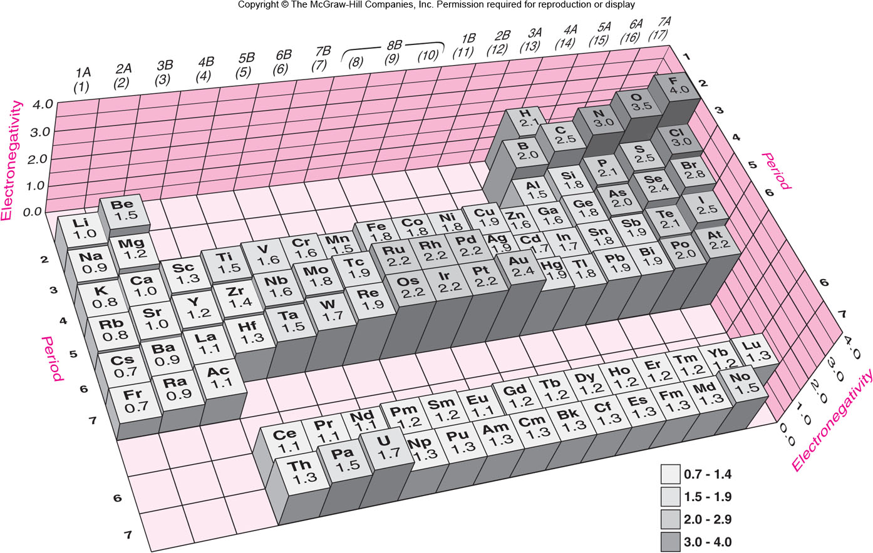
Fig. 2.14 The electronegativity variations in the periodic table.

Slide 33
Metals, Metalloids, and Nonmetals
Reactive metals: (or simply metals): Electro positive materials, have the natural tendency of losing electrons and in the process form cations.
Reactive nonmetals (or simply nonmetals): Electronegative, they have the natural tendency of accepting electrons and in the process form anions.
Metalloids: Can behave either in a metallic or a nonmetallic manner.
Examples:
In group 4A, the carbon and the next two members, silicon and germanium, are metalloids while tin and lead, are metals.
In group 5A, nitrogen and phosphorous are nonmetals, arsenic and antimony are metalloids, and finally bismuth is a metal.

Slide 34
Primary Bonds
Bonding with other atoms, the potential energy of each bonding atom is lowered resulting in a more stable state.
Three primary bonding combinations : 1) metal-nonmetal, 2) nonmetal-nonmetal, and 3) metal-metal.
Ionic bonds: Strong atomic bonds due to transfer of electrons
Covalent bonds: Large interactive force due to sharing of electrons
Metallic bonds: Non-directional bonds formed by sharing of electrons
Permanent dipole bonds: Weak intermolecular bonds due to attraction between the ends of permanent dipoles.
Fluctuating dipole bonds: Very weak electric dipole bonds due to asymmetric distribution of electron densities.

Slide 35
Ionic Bonding
Ionic bonding is due to electrostatic force of attraction between cations and anions.
It can form between metallic and nonmetallic elements.
Electrons are transferred from electropositive to electronegative atoms.
Electropositive
Element
Electron
Transfer
Electronegative
Atom
Electrostatic
Attraction
Cation
+V_{e} charge
Anion
−V_{e} charge
IONIC BOND

Slide 36
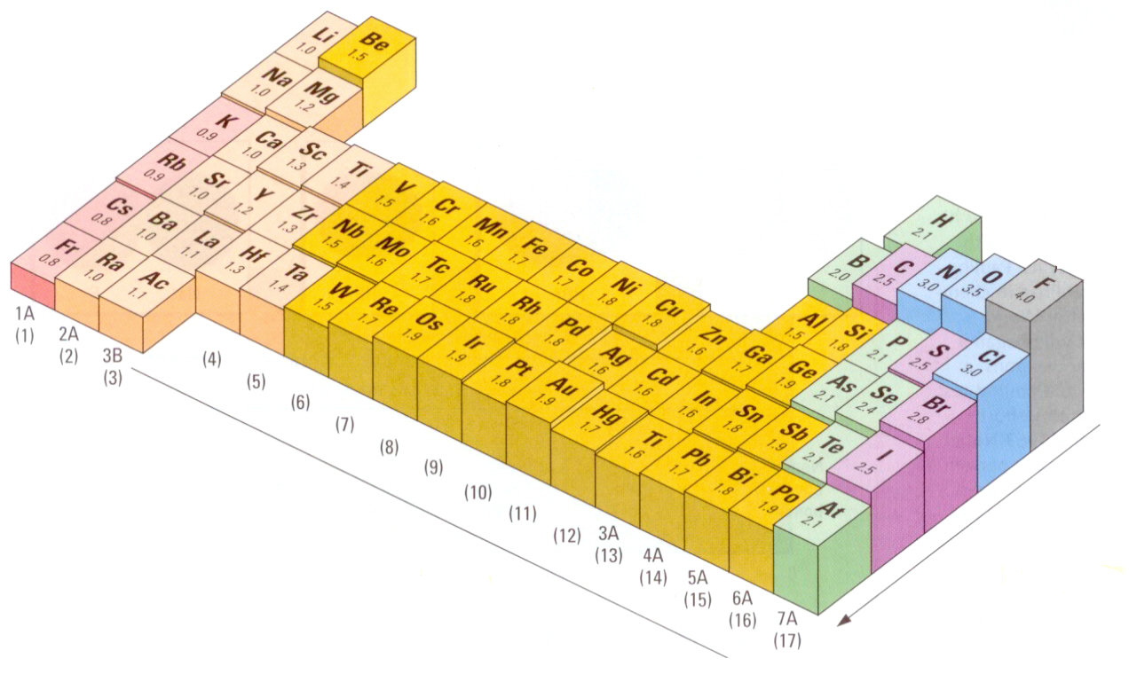
Ionic Bonds
Large difference in electronegativity.
When a metal forms a cation, its radius reduces and when a nonmetal forms an anion, its radius increases.
The electronegativity variations

Slide 37
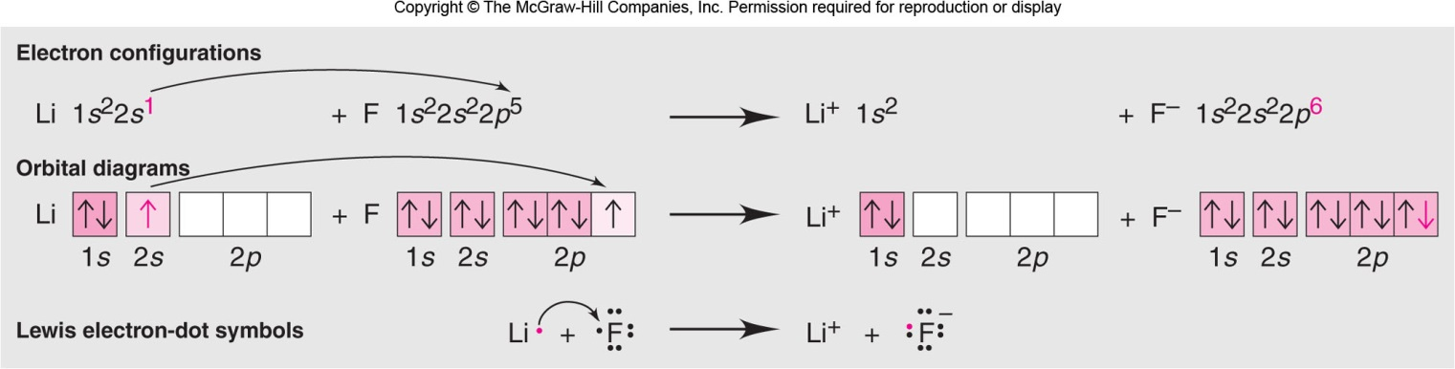
Ionic Bonding – LiF Example
r = 0.157 nm
r = 0.071 nm
r = 0.060 nm
r = 0.136 nm

Slide 38
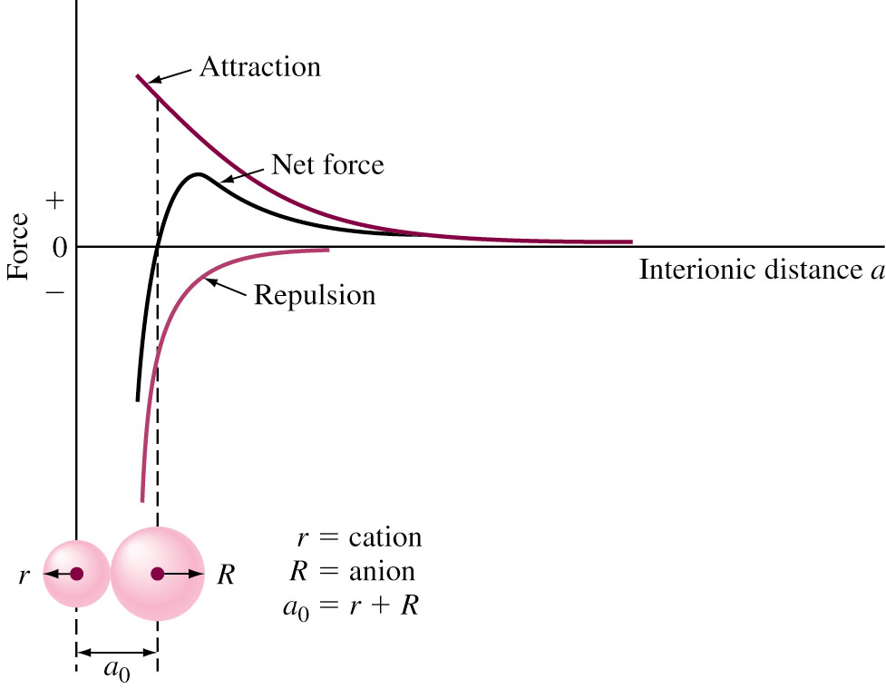
Ionic Force for Ion Pair
Nucleus of one ion attracts electron of another ion.
The electron clouds of ion repulse each other when they are sufficiently close.
These two forces will balance each other when the equilibrium interionic distance, a₀, is reached and a bond is formed.
Fig. 2.16 Force versus separation
distance for a pair of oppositely charged ions
38

Slide 39
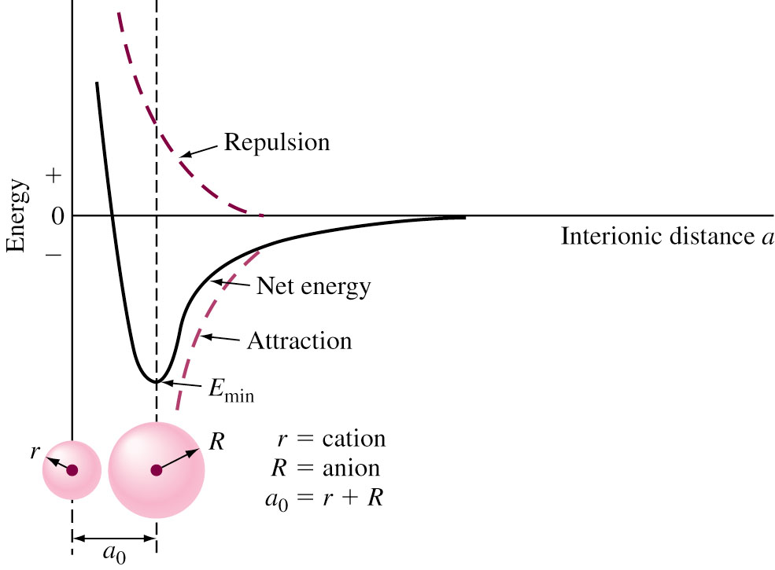
Ion Force for Ion Pair
Z₁, Z₂ = Number of electrons removed or added during ion formation
e = Electron charge, a = Interionic separation distance
ε₀ = Permittivity of free space (8.85 × 10⁻¹² C²/N⋅m²) 真空電容率ε₀⋅μ₀⋅c₀²=1
(n and b are constants)
Fig. 2.17 The energy variations during ionic bonding.

Slide 40
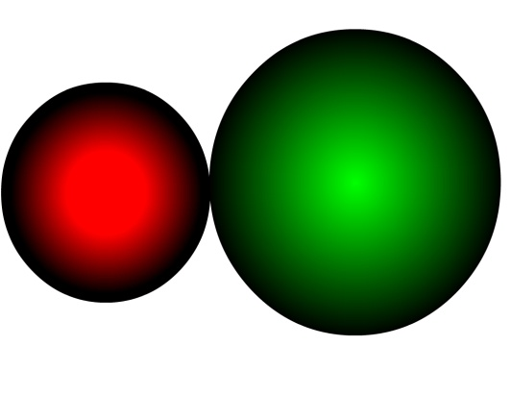
Interionic Force - Example
Force of attraction between Na⁺ and Cl⁻ ions
Z₁ = +1 for Na⁺, Z₂ = −1 for Cl⁻, e = 1.60 × 10⁻¹⁹ C, ε₀ = 8.85 × 10⁻¹² C²/N⋅m², a₀ = Sum of Radii of Na⁺ and Cl⁻ ions
= 0.095 nm + 0.181 nm = 2.76 × 10⁻¹⁰ m.
Na⁺
Cl⁻
a₀

Slide 41
Interionic Energies for Ion Pairs
Net potential energy for a pair of oppositely
charged ions =
E_{net} is minimum when ions are at equilibrium separation distance a₀.
Attraction
Energy
Repulsion
Energy
Energy
Released
Energy
Absorbed

Slide 42
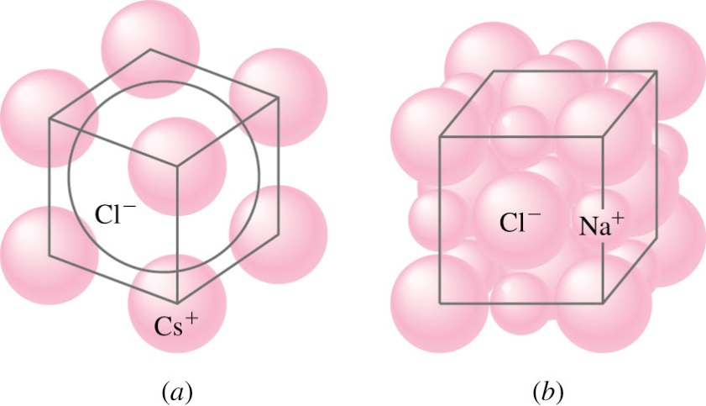
Ion Arrangements in Ionic Solids
Ionic bonds are Non Directional.
Geometric arrangements are present in solids to maintain electric neutrality.
Example: in NaCl, six Cl⁻ ions pack around central Na⁺ Ions.
As the ratio of cation to anion radius decreases, fewer anion surround central cation.
Ionic packing
In NaCl
and CsCl
Figure 2.18
CsCl, 0.169 vs. 0.181 nm
NaCl, 0.095 vs. 0.181 nm

Slide 43
Bonding Energies
Lattice energies and melting points of ionically bonded solids are high.
Lattice energy decreases when size of ion increases.
Multiple bonding electrons increase lattice energy.
Example:
NaCl Lattice energy = 766 kJ/mol
Melting point = 801 °C
CsCl Lattice energy = 649 kJ/mol
Melting Point = 646 ° C
BaO Lattice energy = 3127 kJ/mol
Melting point = 1923 °C

Slide 44
Bonding Energy
Consider production of LiF: result in the release of about 617 kJ/mole (heat of formation).
Step 1. Converting solid Li to gaseous Li (1s²2s¹): 161 kJ/mole of energy. Li_{s} → Li_{g}
Step 2. Converting the F₂ molecule to F atoms: 79.5 kJ/mol. F_{s} → F_{g}
Step 3. Removing the 2s¹ electron of Li to form a cation, Li⁺: 520 kJ/mole. Li_{g} → Li_{g}⁺
Step 4. Transferring or adding an electron to the F atom to form an anion, F⁻: −328 kJ/mol. F_{g} → F_{g}⁻
Step 5. Formation of an ionic solid from gaseous ions: lattice energy, unknown. Li_{g}⁺ + F_{g}⁻ → LiF_{s}
Unknown = −617 kJ – [161 kJ + 79.5 kJ + 520 kJ – 328 kJ] = −1050 kJ (Hess Law)

Slide 45
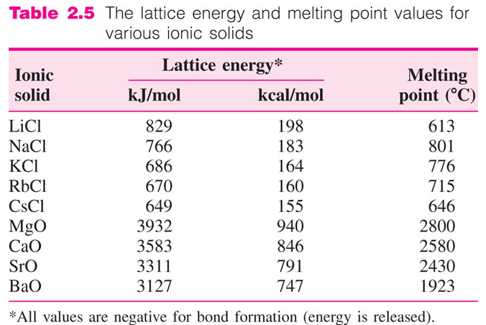
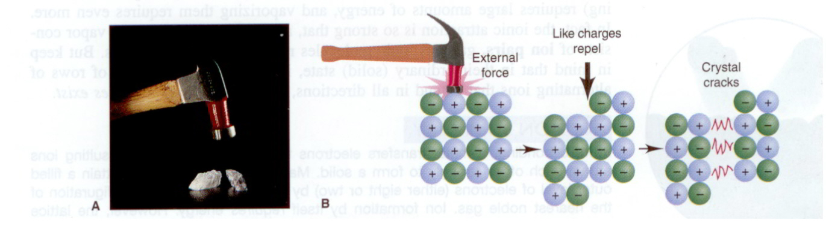
Lattice Energy, Material Properties
Ionic solids are hard, rigid and strong and brittle.
Excellent insulators.
45

Slide 46

Covalent Bonding
In covalent bonding, outer s and p electrons are shared between two atoms to obtain noble gas configuration.
Takes place between elements with small differences electronegativity and close by in periodic table.
In hydrogen, a bond is formed between 2 atoms by sharing their 1s¹ electrons
Electron
Pair
Overlapping Electron Clouds
H + H
H H
H
H
1s¹
Electrons
Hydrogen
Molecule

Slide 47
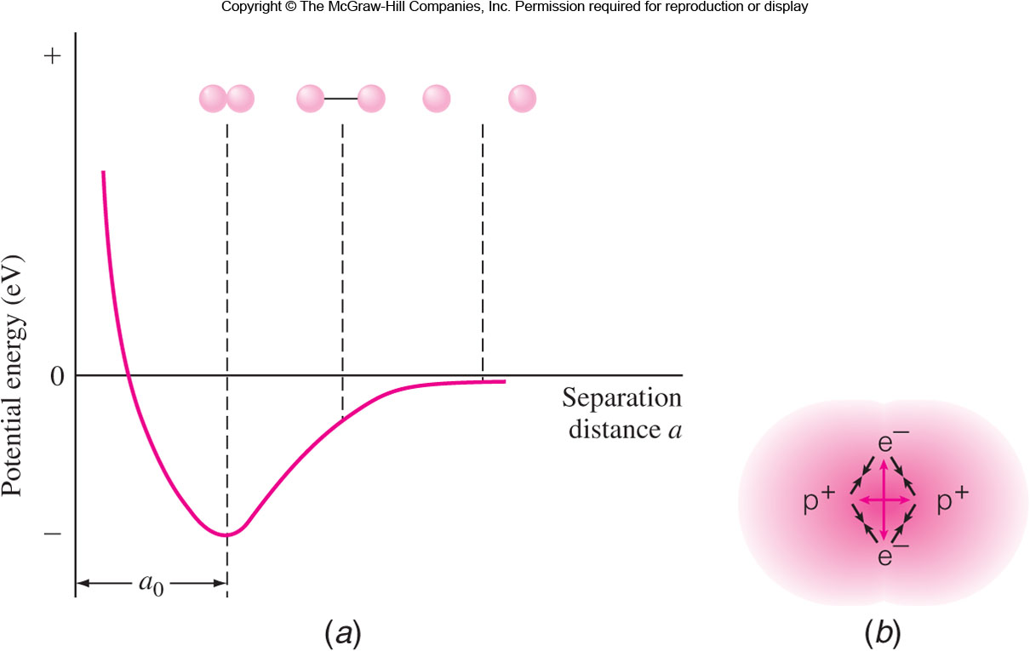
Covalent Bonding Between Hydrogen Atoms
Fig. 2.20 (a) The potential energy diagram and (b) schematic showing the H₂ molecule and their intramolecular forces.

Slide 48
Covalent Bonding - Examples
In case of F₂, O₂ and N₂, covalent bonding is formed by sharing p electrons
Fluorine gas (outer orbital – 2s² 2p⁵) share one p electron to attain noble gas configuration.
Oxygen (Outer orbital - 2s² 2p⁴) atoms share two p electrons
Nitrogen (Outer orbital - 2s² 2p³) atoms share three p electrons
F + F
F F
F F
H
Bond Energy = 160 kJ/mol
O + O
O O
O = O
Bond Energy = 498 kJ/mol
N N
N N
N + N
Bond Energy = 945 kJ/mol

Slide 49
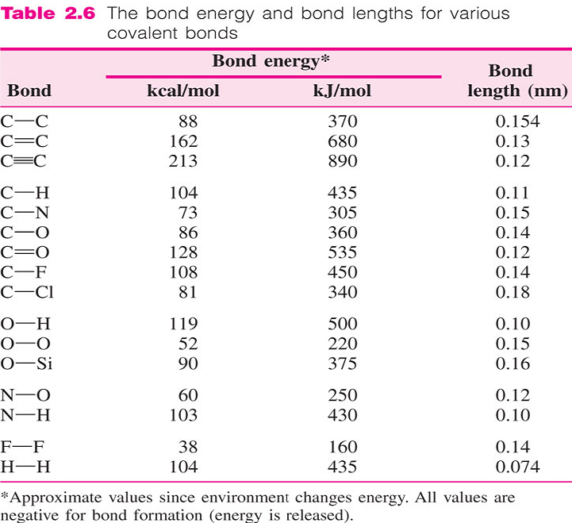
Bond Length, Bond order and Bond Energy
Covalent bonds are direc-tional. Shape, Neighbors.
For a given pair of atoms, with higher bond order, the bond length will decrease; as bond length decreases, bond energy will increase (F₂, N₂)
Nonpolar bonds: sharing of the bonding electrons is between the atoms and the bonds.
Polar covalent bond: sharing of the bonding electrons is unequal (HBr, HF).
49

Slide 50
Covalent Bonding in Carbon
Carbon has electronic configuration 1s² 2s² 2p²
Hybridization causes one of the 2s orbitals promoted to 2p orbital. Result four sp³ orbitals.
Ground State arrangement
Indicates
carbon
forms two
covalent
bonds
1s
2s
2p
Two ½ filed 2p orbitals
Indicates
four covalent
bonds are
formed
1s
sp³
Four ½ filled sp³ orbitals

Slide 51
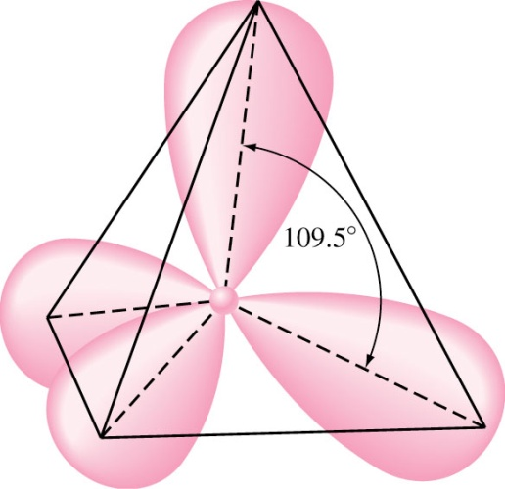
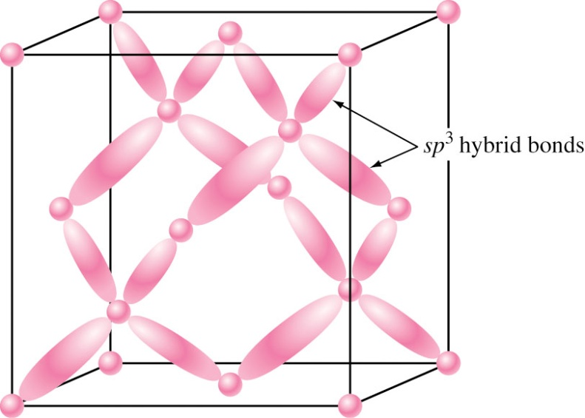
Structure of Diamond
Four sp³ orbitals are directed symmetrically toward corners of regular tetrahedron.
This structure gives high hardness, high bonding strength (711 kJ/mol) and high melting temperature (3550 °C).
Carbon Atom
Tetrahedral arrangement in diamond

Slide 52
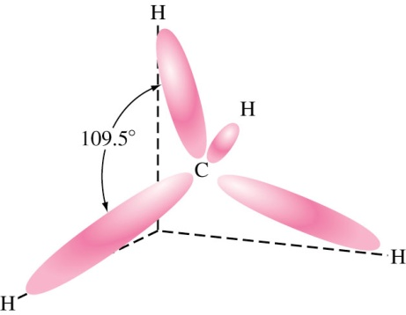
Carbon Containing Molecules
In methane, carbon forms four covalent bonds with hydrogen (1650 kJ/mol).
Molecules are very weekly bonded (~8 kJ/mol). together resulting in low melting temperature (Methane: −183 °C, Ethane: −172 °C n-Buthane: −135 °C).
Carbon also forms bonds with itself.
Molecules with multiple carbon bonds are more reactive.
Methane甲烷
molecule
H
H
H
H
C
C
C
C
H
C
C
H
H
H
H
H
Acetylene乙炔
H
H
Ethane乙烷
Ethylene乙烯

Slide 53
Covalent Bonding in Benzene
Chemical composition of benzene is C₆H₆.
The carbon atoms are arranged in hexagonal ring.
Single and double bonds alternate between the atoms.
H
C
H
H
C
C
C
C
H
H
C
H
Structure of Benzene
Simplified Notations

Slide 54
Covalent Bonding Materials
The covalent bonds between the atoms are very strong and are difficult to break; however, the bond between molecules is weak and breaks easily.
Network covalent solids: The number of neighbors for an atom depends on the number of covalent bonds available.
Quartz: Made up of Si and O atoms, SiO₂, continuously connected to each other through covalent bonds in a 3-D network. Very hard and high melting temperature, 1550 °C.
Covalent materials are poor conductors of electricity not only in a network solid form but also in a liquid or molten form.

Slide 55
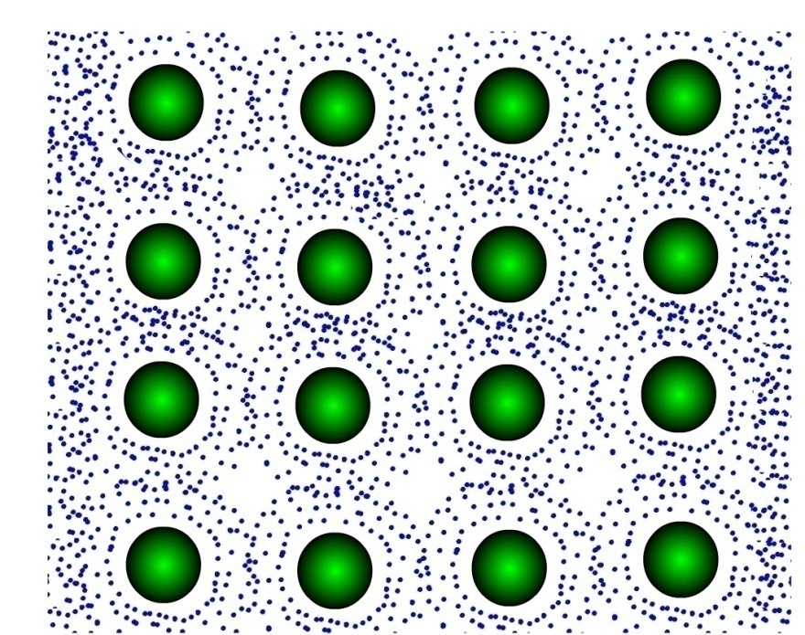
Metallic Bonding
Atoms in metals are closely packed in crystal structure.
Loosely bounded valence electrons are attracted towards nucleus of other atoms.
Electrons spread out among atoms forming electron clouds.
These free electrons are
reason for electric
conductivity and ductility.
Since outer electrons are
shared by many atoms,
metallic bonds are
Non-directional.
Positive Ion
Valence electron charge cloud

Slide 56
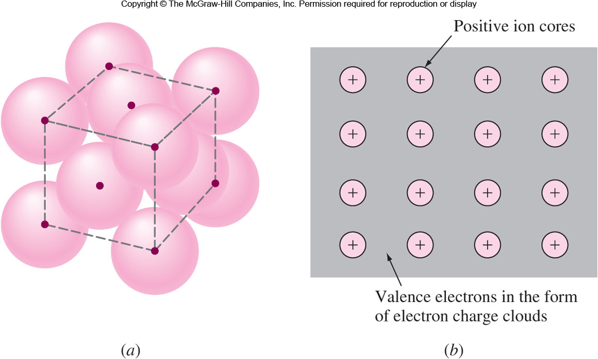
Fig. 2.27 (a) The order, efficiently packed structure of copper atoms in a metallic solid. (b) The positive ion and the surrounding sea of electrons model for metallic bonding.

Slide 57
Metallic Bonds (Cont..)
Overall energy of individual atoms are lowered by metallic bonds.
Minimum energy between atoms exist at equilibrium distance a_{0.}
Fewer the number of valence electrons involved, more metallic the bond is.
Example: Na Bonding energy : 108 kJ/mol,
Melting temperature: 97.7 °C.
Higher the number of valence electrons involved, higher is the bonding energy.
Example: Ca Bonding energy: 177 kJ/mol,
Melting temperature: 851 °C.

Slide 58
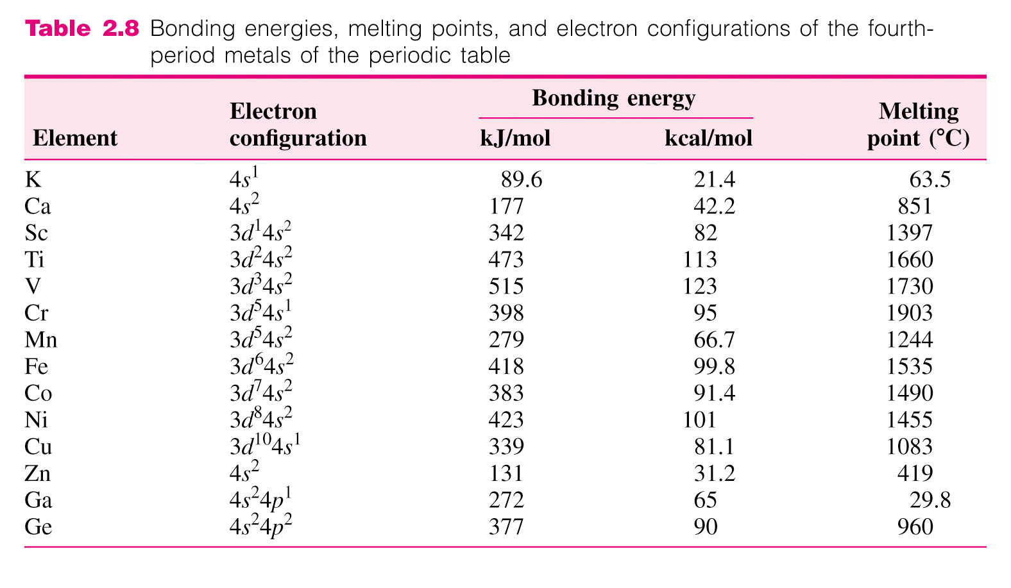
Metallic Bonds and Material Properties
The bond energies and the melting point of metals vary greatly depending on the number of valence electrons and the percent metallic bonding.

Slide 59
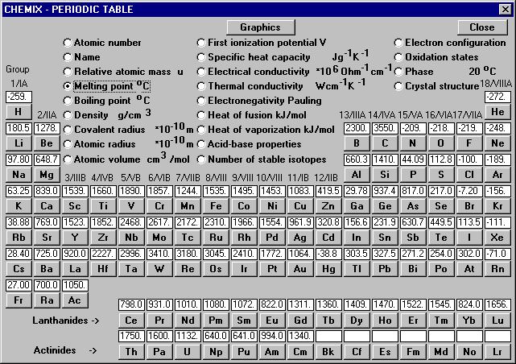
http://www.chemix-chemistry-software.com/school/periodic_table/melting-points-table.html

Slide 60
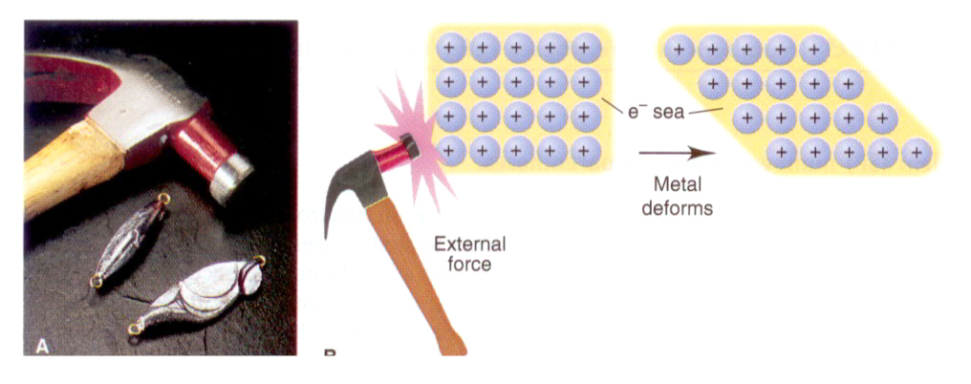
Metallic Bonds and Material Properties
Pure metals are significantly more malleable than ionic or covalent networked materials.
Strength of a pure metal can be significantly increased through alloying.
Pure metals are excellent conductors of heat and electricity.

Slide 61
Mixed Bonding
Chemical bonds can involve more than one type of primary bond and can also involve secondary dipole bonds.
Ionic-Covalent Mixed Bonding: Most covalent-bonded molecules have some ionic binding, and vice versa.
Pauling proposed an equation to determine X_{A} and X_{B} are the electronegativities of A and B atoms.
Many semiconducting compounds have mixed ionic-covalent bonding. GaAs: 4%, ZnSe: 15% ionic character.
Metallic-Covalent Mixed Bonding: Transition metals have some covalent bonds. Si and Ge have some metallic bonds.
Metallic-Ionic Mixed Bonding: Intermetallic compounds may have a significant amount of electron transfer. NaZn₁₃, Fe₅Zn₂₁.

Slide 62

Secondary Bonding
Secondary bonds are due to attractions of electric dipoles in atoms or molecules.
Dipoles are created when positive and negative charge centers exist.
There two types of bonds permanent and fluctuating van der Waals bonds (forces).
Dipole moment = μ = q⋅d
q = Electric charge
d = Separation distance
1 debye = 3.34 × 10⁻³⁰ C⋅m
−q
+q
-q
Figure 2.26
d
離子鍵: 0.2 nm × 1.6 × 10⁻¹⁹ C
= 3.2 × 10⁻²⁹ C⋅m ~ 10 debye

Slide 63
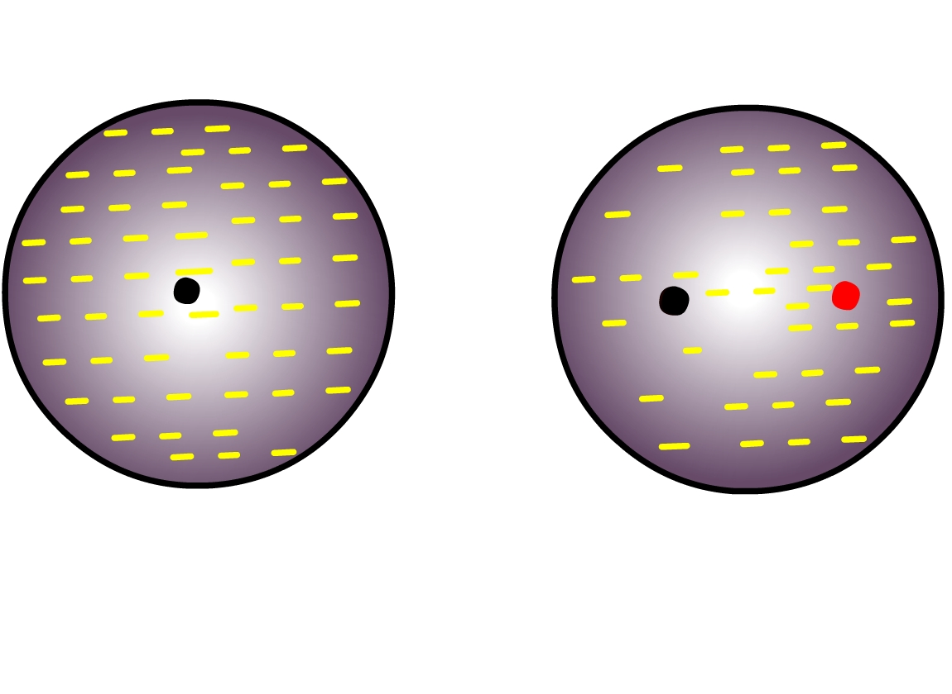
Fluctuating Dipoles
Weak secondary bonds in noble gases.
Dipoles are created due to asymmetrical distribution of electron charges.
Electron cloud charge changes with time.
Symmetrical
distribution
of electron charge
Asymmetrical
distribution
(changes with time)

Slide 64
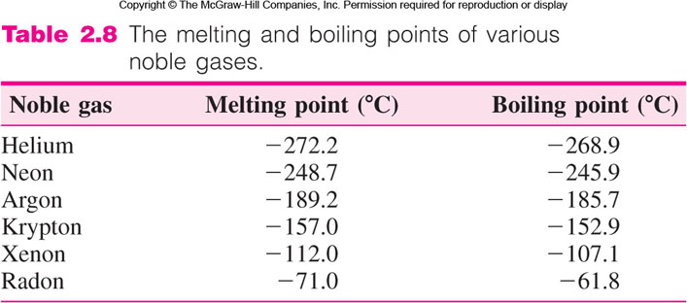
Fluctuating Dipoles
Fluctuating dipoles of nearby atoms can attract each other, creating weak interatomic nondirectional bonds.
The melting and boiling points increase with increasing the atomic size of the noble gases.

Slide 65
Permanent Dipoles
Dipoles that do not fluctuate with time are called permanent dipoles.
Examples:
Symmetrical
arrangement
of 4 C-H bonds
No Dipole
moment
b.p.: −128 °C
CH₄
Asymmetrical
tetrahedral
arrangement
Creates
dipole b.p.: −14 °C
CH₃Cl

Slide 66
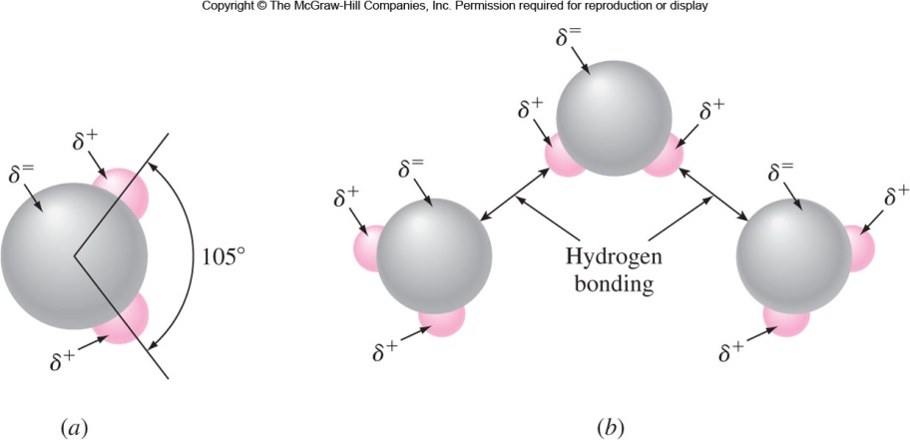
Hydrogen Bonds
Hydrogen bonds are Dipole-Dipole interaction between polar bonds containing hydrogen atom.
Water: Dipole is created due to asymmetrical arrange-ment of hydrogen atoms. Attraction between negative oxygen pole and positive hydrogen pole. b.p.: 100 °C.
Hydrogen bond: 29 kJ/mol vs. Fluctuating dipole bond: 2-8 kJ/mol.

Slide 67
Summary
Atom: protons + neutrons + electron cloud (valence electrons: chemical reaction)
Electrons: quantized energy levels. ΔE = hν
Four quantum numbers: n, l, m_{l}, m_{s}. Pauli’s priciple.
Strong Primary Bonds: 90-890 kJ/mol
Ionic: Coulombic forces, nondirectional, size, charge.
Covalent: Sharing electron pairs, orbital overlaps, directional.
Metallic: Mutual sharing, fewer e, more delocalized, nondir...
Mixed Bonds: Ionic-covalent, metallic-covalent, metallic-ionic
Secondary Bonds: 2-40 kJ/mol
Fluctuating dipole: Asymmetrical e distribution, noble gases.
Permanent dipole: Polar bonded molecules, H₂O, C-H, N-H

